Slide 1
Biochem 3BP3 Internet of Things & Big Data
"The ratio of facts per decision is exponentially growing"
- Dr. Anna Goldenberg, University of Toronto
Lecture 12 is not included in BIOCHEM 3BP3 during Fall 2024
See a previously recorded version at https://github.com/agmcarthur/Biochem-3BP3

Slide 2
Bacteria are evolving drug resistance faster than we can discover new drugs

Slide 3
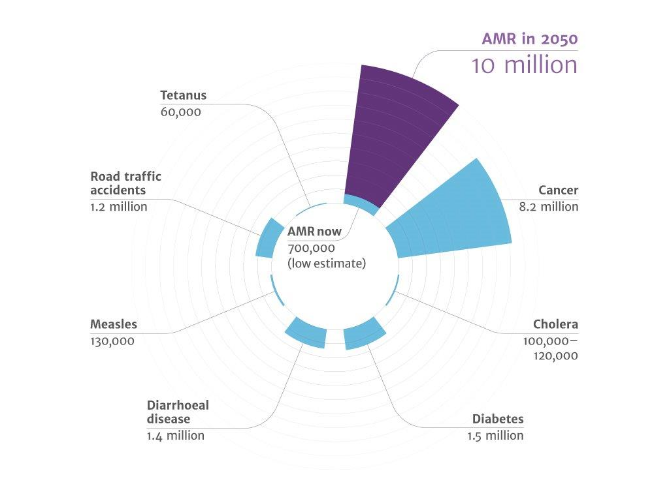
Drug resistant death rate is increasing

Slide 4
The once treatable are becoming untreatable

Slide 5
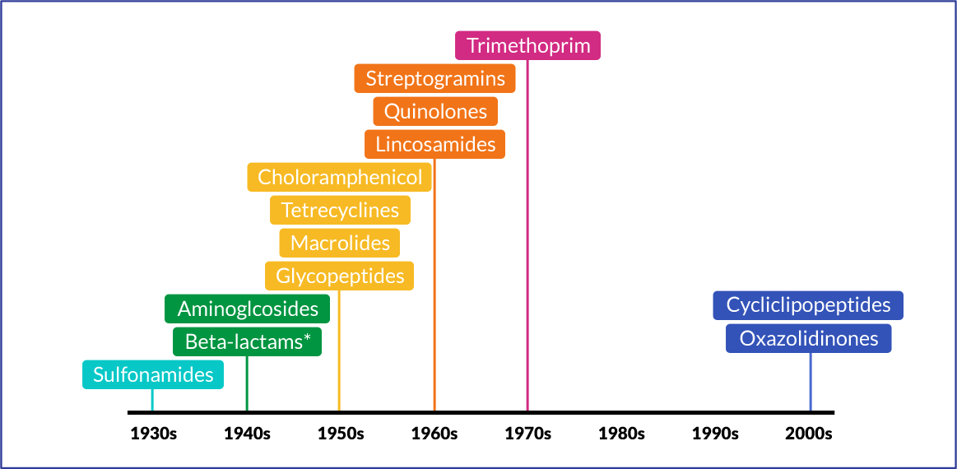
We are at risk of entering a ‘post-antibiotic era’

Slide 6
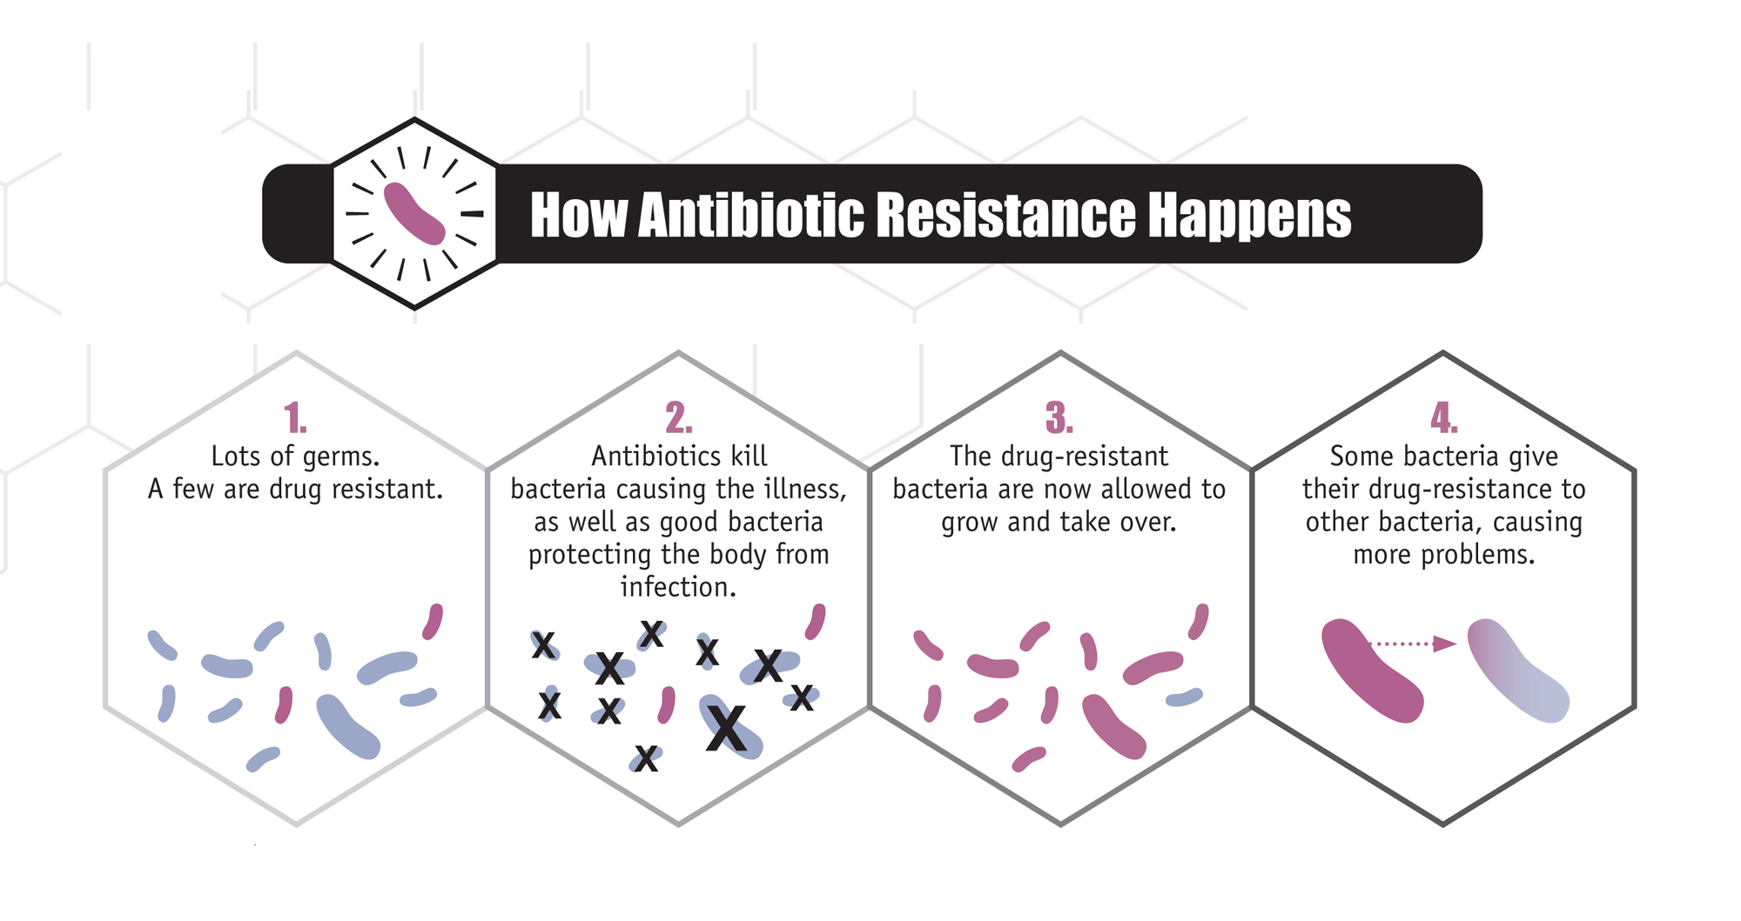
Overuse and misuse increase drug resistance

Slide 7
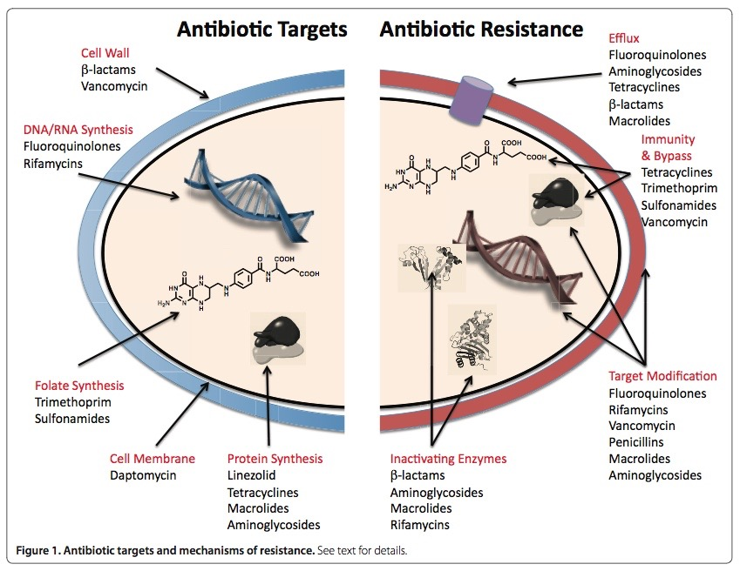
Drug resistance is in bacterial genes

Slide 8
Threats emerge quickly
NDM-1 metallo-beta-lactamase

Slide 9
Which resistance genes are in Canada? Which genes are moving around? Which pose a threat?

Slide 10
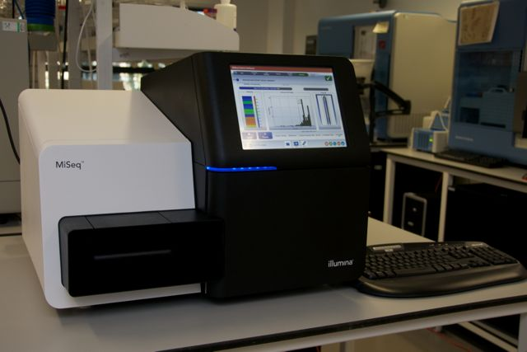
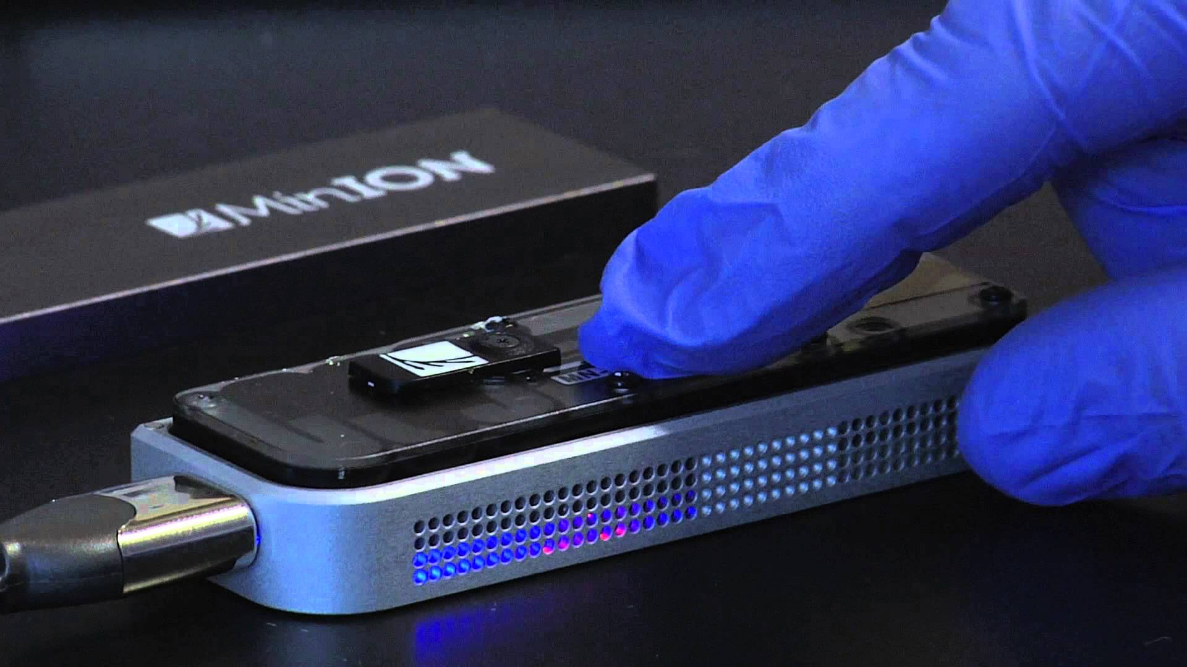
DNA Sequencing – Resistance Genes Can No Longer Hide
Illumina DNA sequencer
Nanopore DNA sequencer

Slide 11
DNA Sequencing – Resistance Genes Can No Longer Hide
Salmonella genome sequence
CTGTCCCTTGGCTTTTTTTACTATGGTCTCGAAATGAACGTTTGTATGACTTTGCCATCC
GCTTGACGCTCTTCATAGTGATTGGCTGTGTAATCGCGGATGCTCGCACGCCAAAAGCCG
ATGGCAGGCATGTTGTTTTCCAATTGAAAGACTTCCCAGGCACCCGGGAACATTTTGAAG
ATTTGATGGGAGACCGCTTTTCCGATTCCCAGCCGACGGTAGCGTTTCATGATAAAAAAT
TCAGCAATGGAGTGGATCGATGGCAAATTTGCATCAGGGCTTGTGAGCATGCGGACGAGG
ACAAAACCAGCCAGCTTACCATTAACCTTGATGAAAAAGGGATGGCGCTCTGGTTCAACC
CAATATTTCTCAAAGTAGTCGTAGCCAAACAAGCCGTCGTCATCTACTTCGAAAGGCTCA
AACTCAGTGAAGTCGTACGTATACAGCTCCAACAGTTGCTTGAGAGCGTGCTTCTGTTCA
AAAGGAACTCGTTCTATCGAGAATGCTTGATTCACTGAGAAAACCTCCTTTTTTCTTGAG
ATATAGGAGTATCGTACTTTATTTTTTAGGTTGTGGGAACATATGGTGGACACTTCTTTA
TAGAACCTCACACGATTGATCATTTTACTTGAGGTGGTTCCAGTCGGGCTATACTAGAGT
CAAACGAAAGAAAATCAATACGAAGCAAGACAGCAGCCATACGGTGATCAGCCGGGTGGC
TGAATTGTTATTCTTATCTCAATAACAGCCTCGAGAATGTAACAACTGGGAGACGAACGA
CAAATTAATCAACGGAAACATCACATAATAGGATGGCGATGTAAAGTGAAGGTACTTGGT
CATTTCTTTTCTAAAGATGACATGGAGGAAATATCCGTATTAAAAGATCTATGTATTGGG
ATTAGTGTAAATGGTAGTCCTTTTATATGCTTTGAGGTACTAGATGATATTTTTCAGGAA
CGATATAAGCTTAGTCAACTATCAAGAGAAAAATTATTAATAATTGCAGGGCAGTTACAG
Multidrug resistant Salmonella

Slide 12
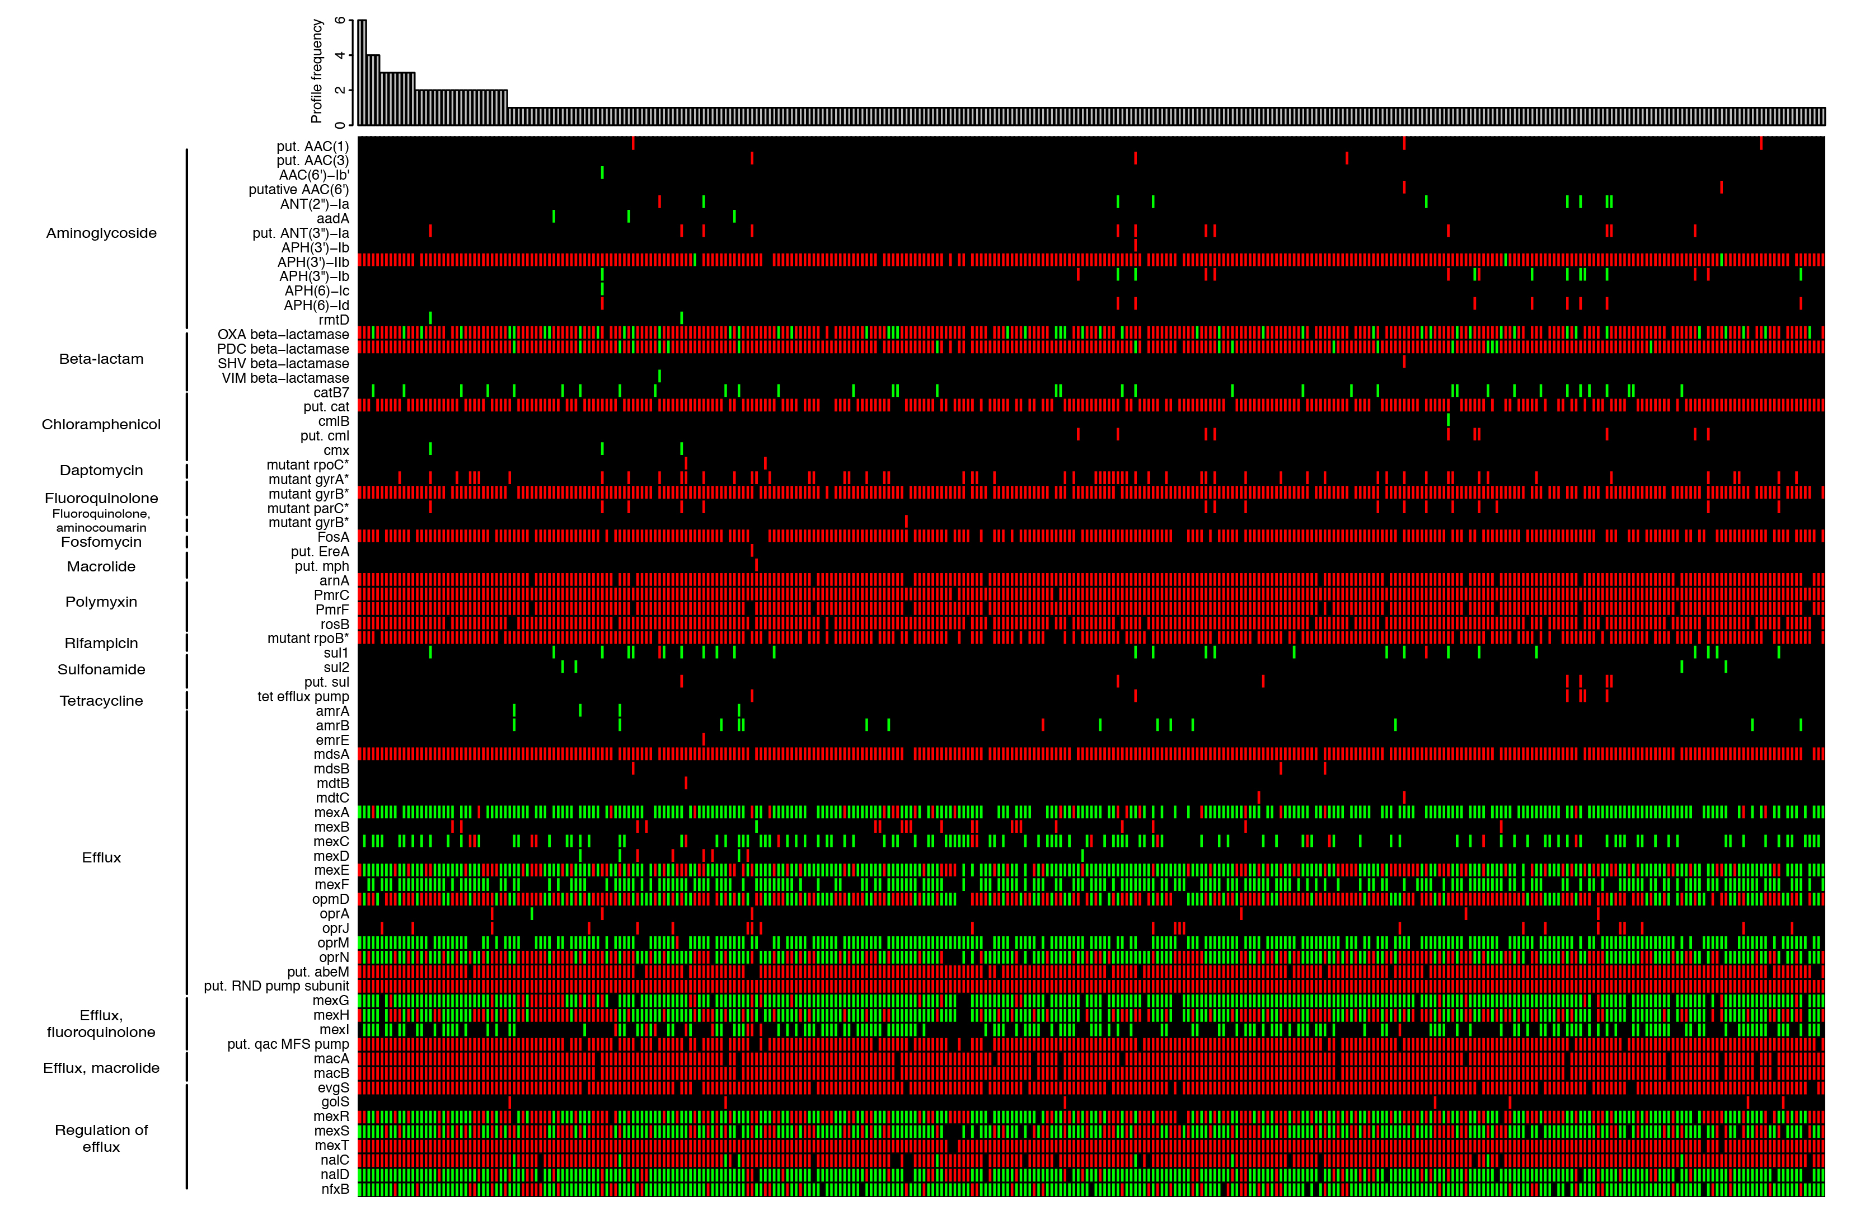
DNA Sequencing – Resistance Genes Can No Longer Hide
Drug resistance in Cystic Fibrosis associated Pseudomonas

Slide 13
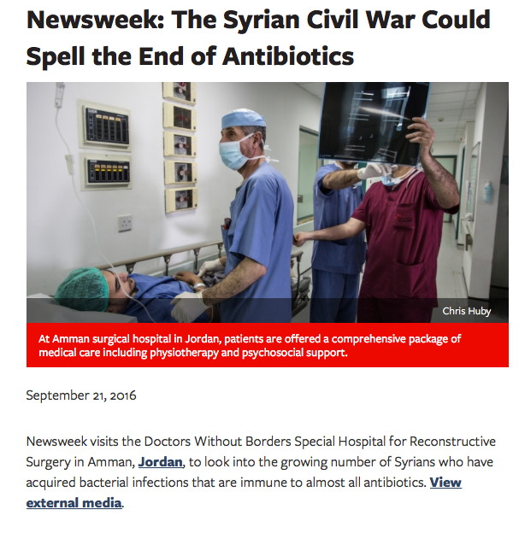
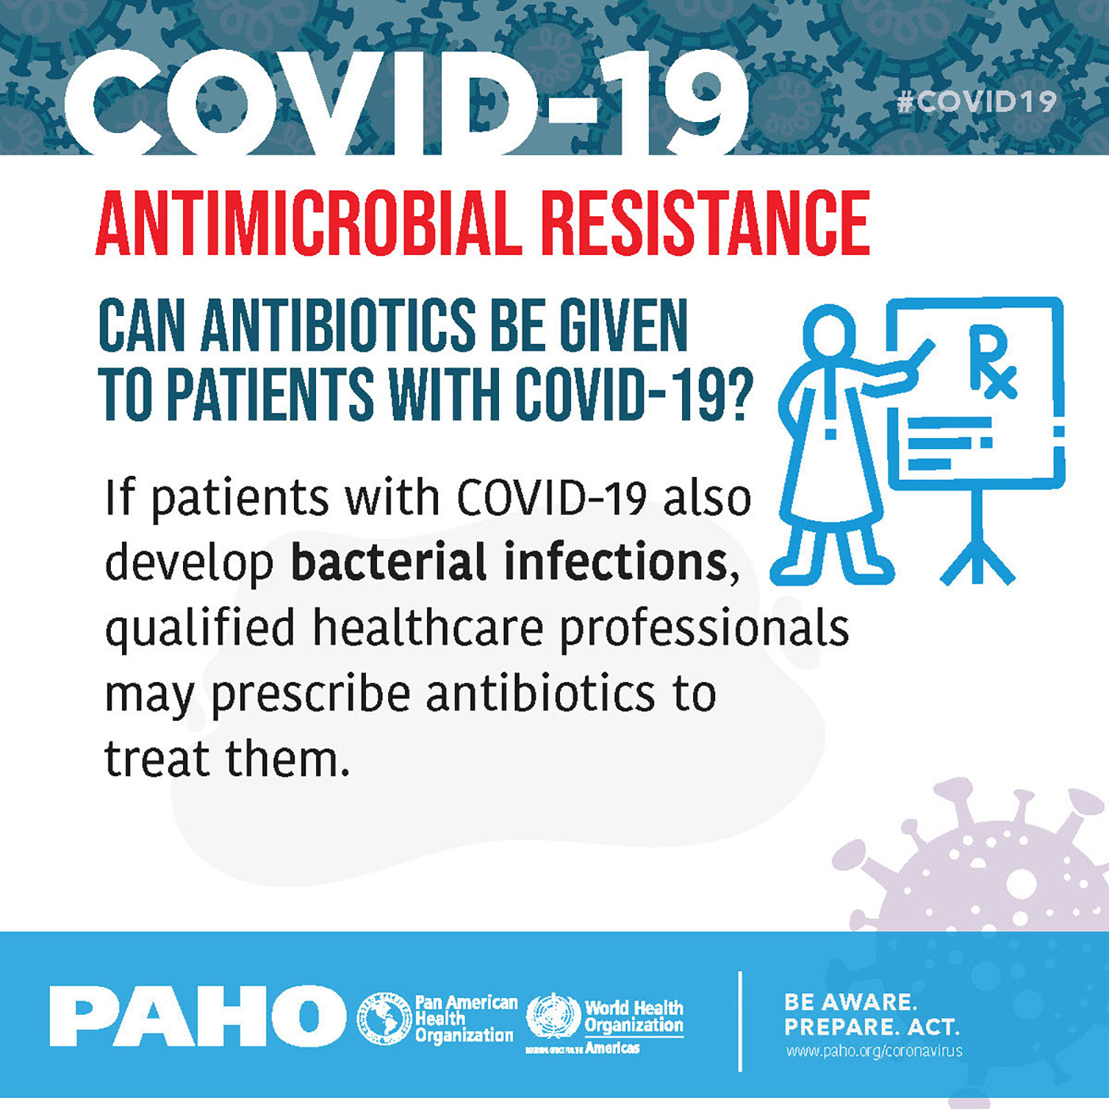
What will informatics need to look like when we sequence at every hospital, clinic, and outbreak? How do we build a surveillance network for drug resistance?

Slide 14
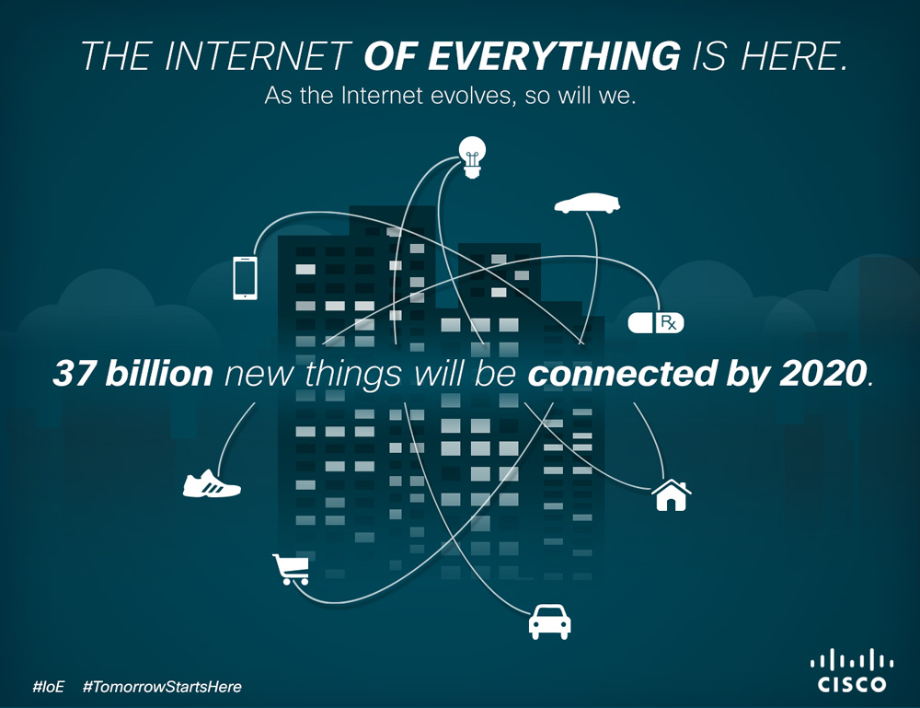
Sharing Data – The Internet of Everything

Slide 15
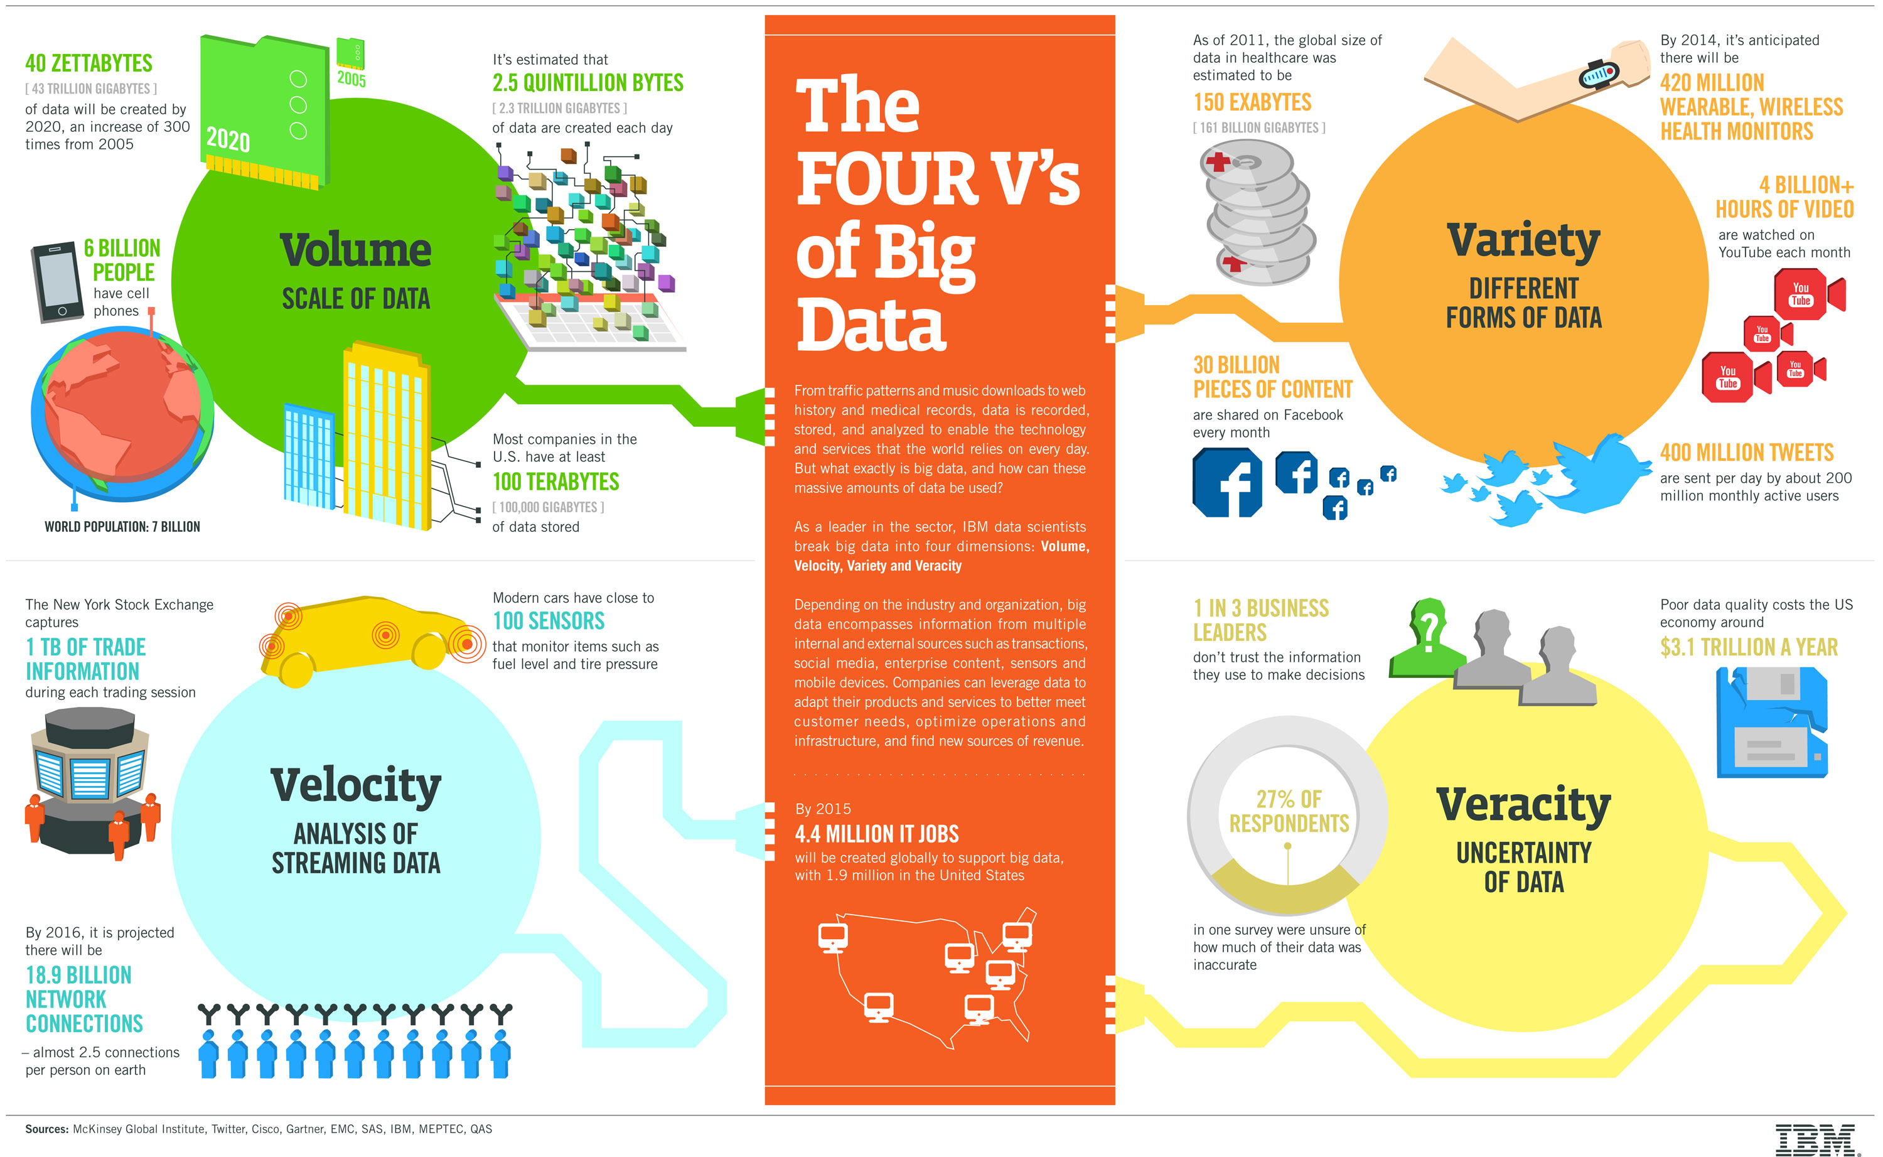
Sharing Data – The Internet of Everything
The Fifth V: Value

Slide 16
Big Data - Creating an AMR Surveillance Network
McArthur & Wright. 2015. Current Opinion in Microbiology, 27, 45-50.

Slide 17
Rapid Response Strategies Early Detection of Emergent Threats Inform Public Policy Guide Clinical Practice Enable Targeted Drug Development

Slide 18
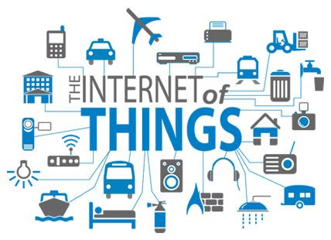
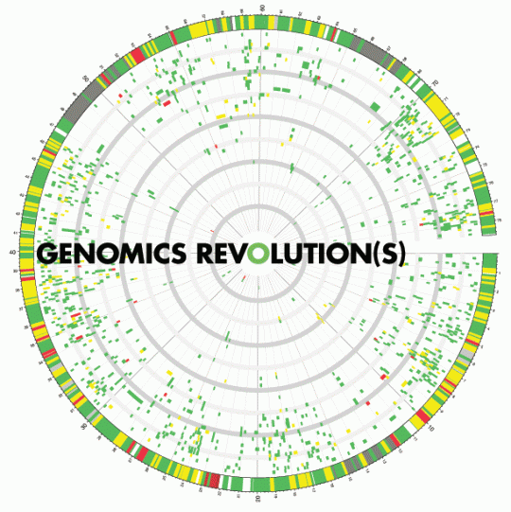

Collaboration is Key – Academia, Government, and Industry

Slide 19
Exome Sequencing and Personalized Medicine

Slide 20
Genome Wide Association Studies (GWAS)
Powerful method to determine genetic underpinnings of disease
Cohort of unrelated people with a shared disorder
Control cohort
Sequence individual genomes or exomes
Detect shared mutations absent in control group
Research leads – molecular basis of disease
Patient screening – genetic counseling
Patient data tightly controlled
Only association statistics shared and published

Slide 21
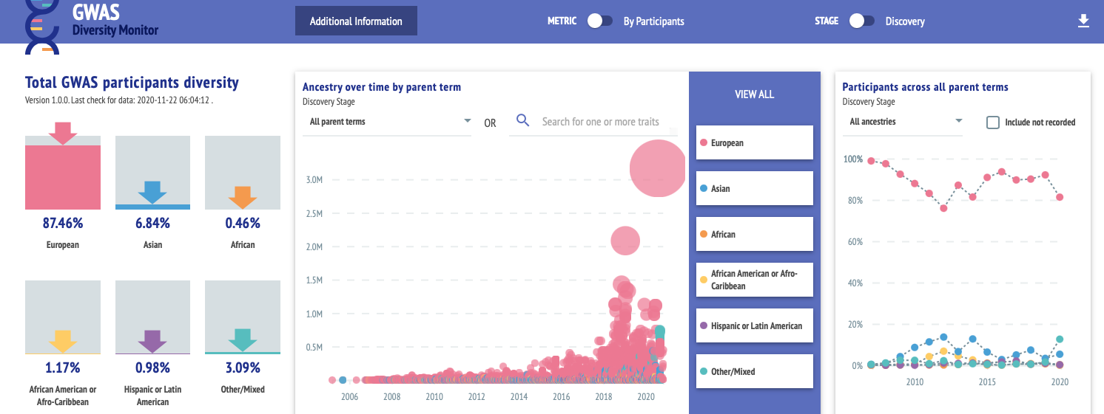
Genome Wide Association Studies (GWAS)
Powerful method to determine genetic underpinnings of disease
Cohort of unrelated people with a shared disorder
Control cohort
Sequence individual genomes or exomes
Detect shared mutations absent in control group
Research leads – molecular basis of disease
Patient screening – genetic counseling
Patient data tightly controlled
Only association statistics shared and published
https://gwasdiversitymonitor.com

Slide 22
Proposed Internet of DNA
A global network of millions of human genome sequences
$1000 genome in 1 hour
Genomic data organized with associated medical records
GWAS Informatics – “cohort mining”
Rare disorders – “rare variant mining”
Complex diseases require depth of sampling and statistical approaches not possible without data sharing
Technical solutions exist, e.g. secure Peer to Peer networks
Major barrier is unresolved privacy and ethical issues
See Global Alliance for Genomics and Health, genomicsandhealth.org

Slide 23
Proposed Internet of DNA
Moore’s Law
Kryder’s Law
NGS
Sboner et al. 2011. The real cost of sequencing: higher than you think! Genome Biol. 12(8):125.
Stein. 2010. The case for cloud computing in genome informatics. Genome Biol. 11(5):207.
Non-centralized data sharing needed
Shared the burden, share the data, and share the infrastructure
Stein et al. 2015. Data analysis: Create a cloud commons. Nature 523:149-51.

Slide 24


Proposed Internet of DNA
Non-centralized data sharing
Heterogenous data sharing
Globalized analytics
Local rules – each country, hospital, clinic, agency, or even patient can set their own data sharing limits
Each can share data and metadata within local legal and ethical standards

Slide 25
Proposed Internet of DNA
Non-centralized data sharing
Heterogenous data sharing
Globalized analytics
Local rules – each country, hospital, clinic, agency, or even patient can set their own data sharing limits
Each can share data and metadata within local legal and ethical standards
See Integrated Rapid Infectious Disease Analysis (IRIDA), www.irida.ca

Slide 26
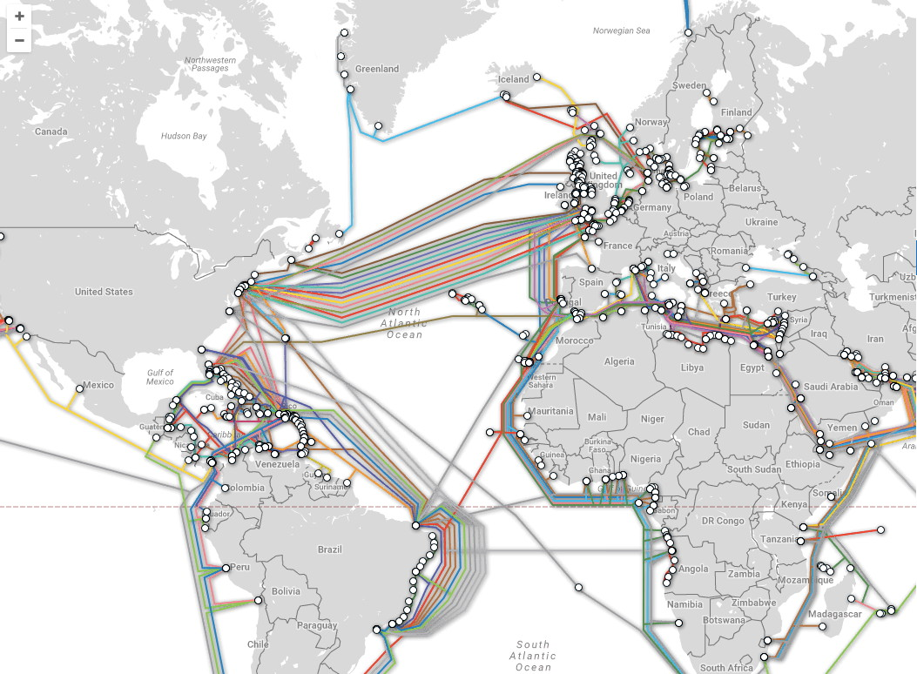
How are we going to move all that data?
Butters' Law (amount of data coming out of an optical fiber is doubling every nine months)

Slide 27
Generation
Big Data
Analytics

Slide 28
Personalized Benefit
Generation
Big Data
Analytics
Corporate
Benefit
Public
Benefit
Research
Benefit

Slide 29
Personalized Benefit
Privacy
Consent
Generation
Big Data
Analytics
Corporate
Benefit
Public
Benefit
Research
Benefit

Slide 30
Personalized Benefit
Privacy
Consent
Generation
Big Data
Analytics
Data sharing
Data value
Corporate
Benefit
Public
Benefit
Research
Benefit

Slide 31
Generation
Big Data
Analytics
Genome sequencing and bioinformatics
Cloud Computing
Research – Government - Industry
Tech Adoption
in the Public Sphere

Slide 32
Big Data in Biomedicine - Issues
A new paradigm
data in motion versus data at rest
unstructured metadata
“Literature is informative, but not information” – Dr. Suzanna Lewis
Infrastructure
data generation, storage, and access
data movement, security
Analytical accuracy
Patient confidentiality, privacy, and consent
Data sharing, depersonalization, and re-personalization

Slide 33
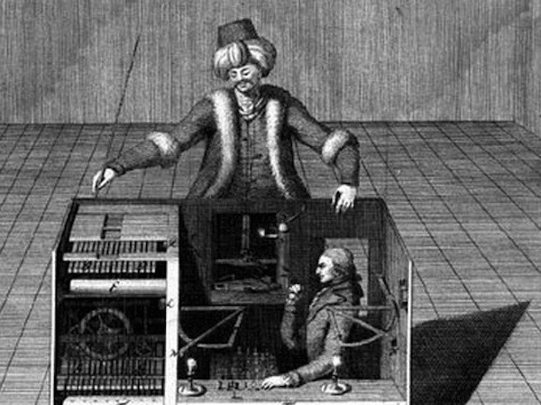
Literature is informative, but not information
Text Mining
Mechanical Turk
Software driven
Semantic web, ontology, controlled vocabulary methods
Language processing
Predict associations and interactions
The Mechanical Turk, late 18th Century

Slide 34
Literature is informative, but not information
Text Mining
Amazon Mechanical Turk
Software driven
Semantic web, ontology, controlled vocabulary methods
Language processing
Predict associations and interactions
Crowdtasking
Micro-economic model
Veracity analysis
Record associations and interactions

Slide 35
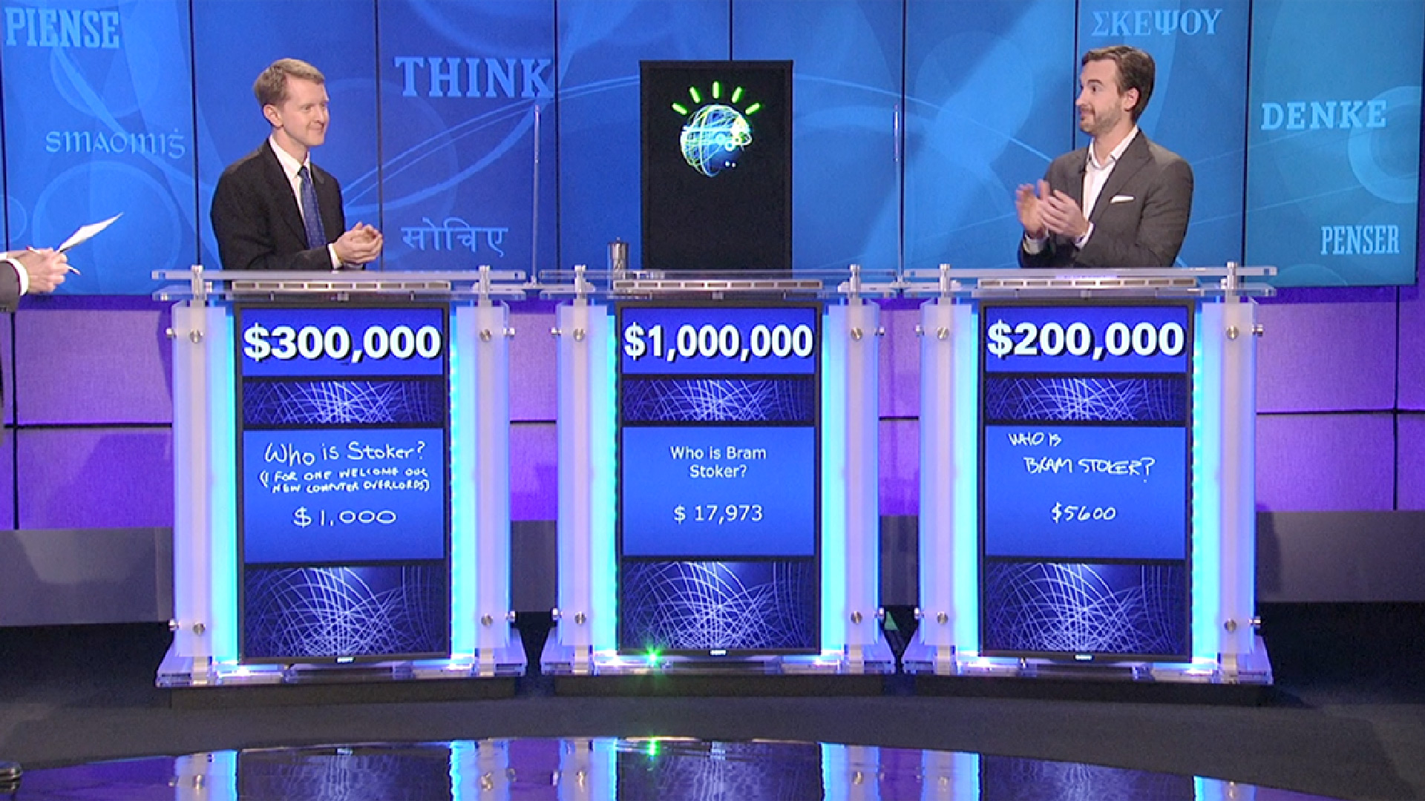
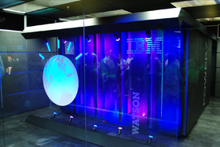
Infrastructure
IBM’s Watson
Natural language processing relative to a knowledgebase
A form of artificial intelligence
Machine learning!
$3 million cost
Primary research aim is Health Care
“Clinical Decision Support System” using Evidence Based Medicine
Currently in testing for lung cancer treatment decision making

Slide 36

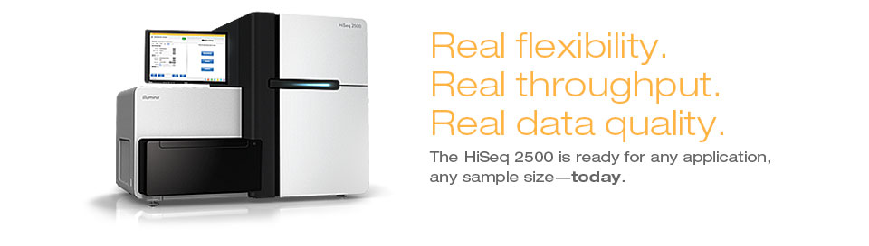
Infrastructure
2.6 Petabytes of Storage for Total Library = 2.6 x 10¹⁵ bytes
DNA sequencing expected in the 85 x 10¹⁵ range for 2016 (MIT Tech Review)

Slide 37
Analytical Accuracy

Slide 38
Analytical Accuracy

Slide 39
Privacy & Consent
HeLa cells
important immortal cell line
derived from human cervical cancer cells
numerous patents and millions in profits from use of HeLa cells

Slide 40
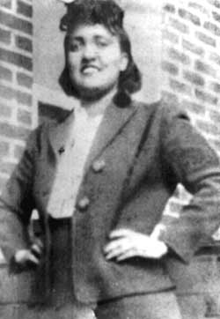
Privacy & Consent
HeLa cells
important immortal cell line
derived from human cervical cancer cells
numerous patents and millions in profits from use of HeLa cells
Derived from Henrietta Lacks without her knowledge or consent
Family unaware for decades that their maternal ancestor’s cells were being used in labs worldwide
More biomass of derived cells than there were in Henrietta Lacks herself
Henrietta Lacks
(August 1, 1920 – October 4, 1951)

Slide 41

Data Sharing, Depersonalization, Re-Personalization
Depersonalization strategies
Do not store personal data
Anonymize personal data
Do not share personal data
Generalize personal data

Slide 42
Data Sharing, Depersonalization, Re-Personalization
Depersonalization
Do not store personal data
Anonymize personal data
Do not share personal data
Generalize personal data
Re-personalization
Determining identity by algorithm
Linking disparate data increases odds of solution

Slide 43
Data Sharing, Depersonalization, Re-Personalization
Depersonalization
Do not store personal data
Anonymize personal data
Do not share personal data
Generalize personal data
Re-personalization
Determining identity by algorithm
Linking disparate data increases odds of solution
Moving forward?
The major challenges are legal and ethical, not technical

Slide 44
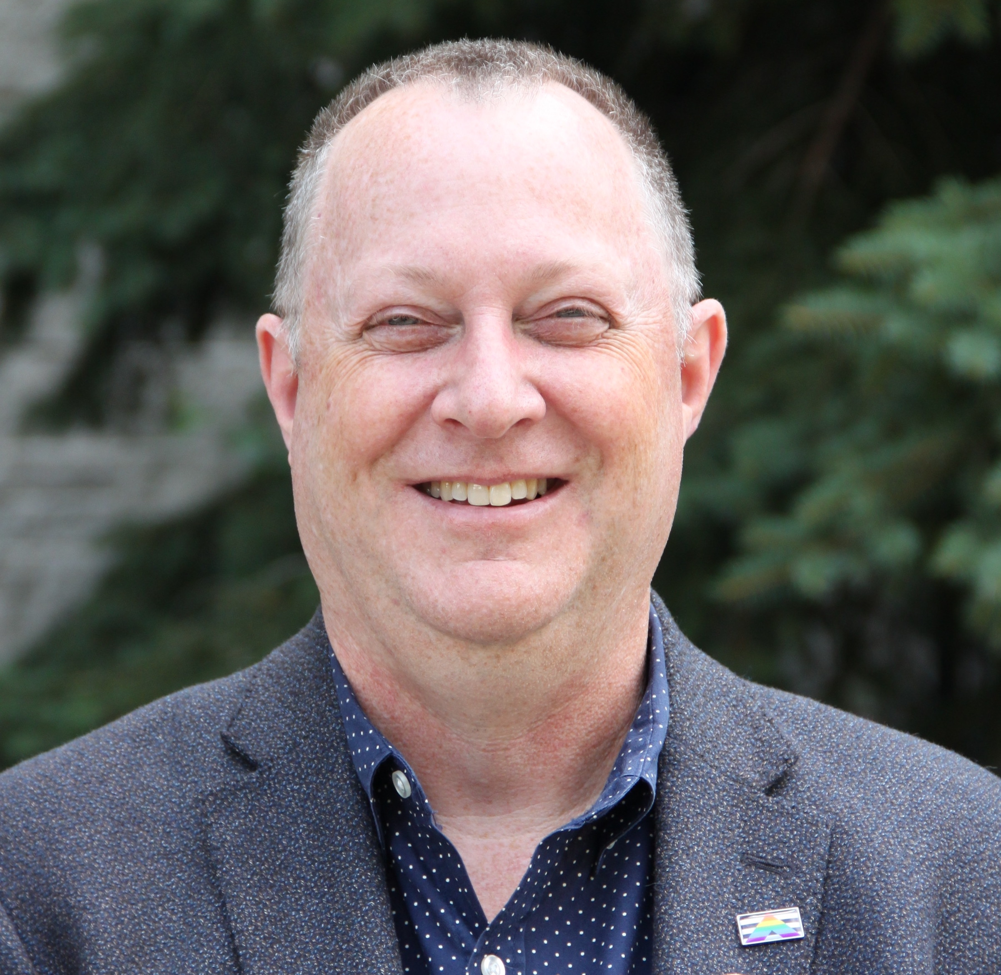
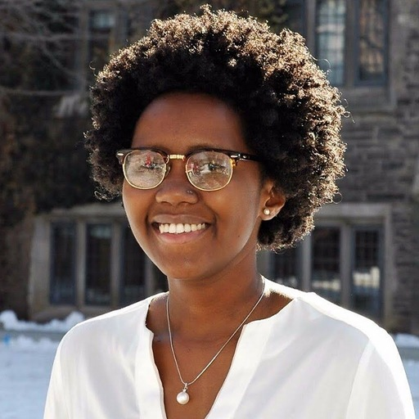
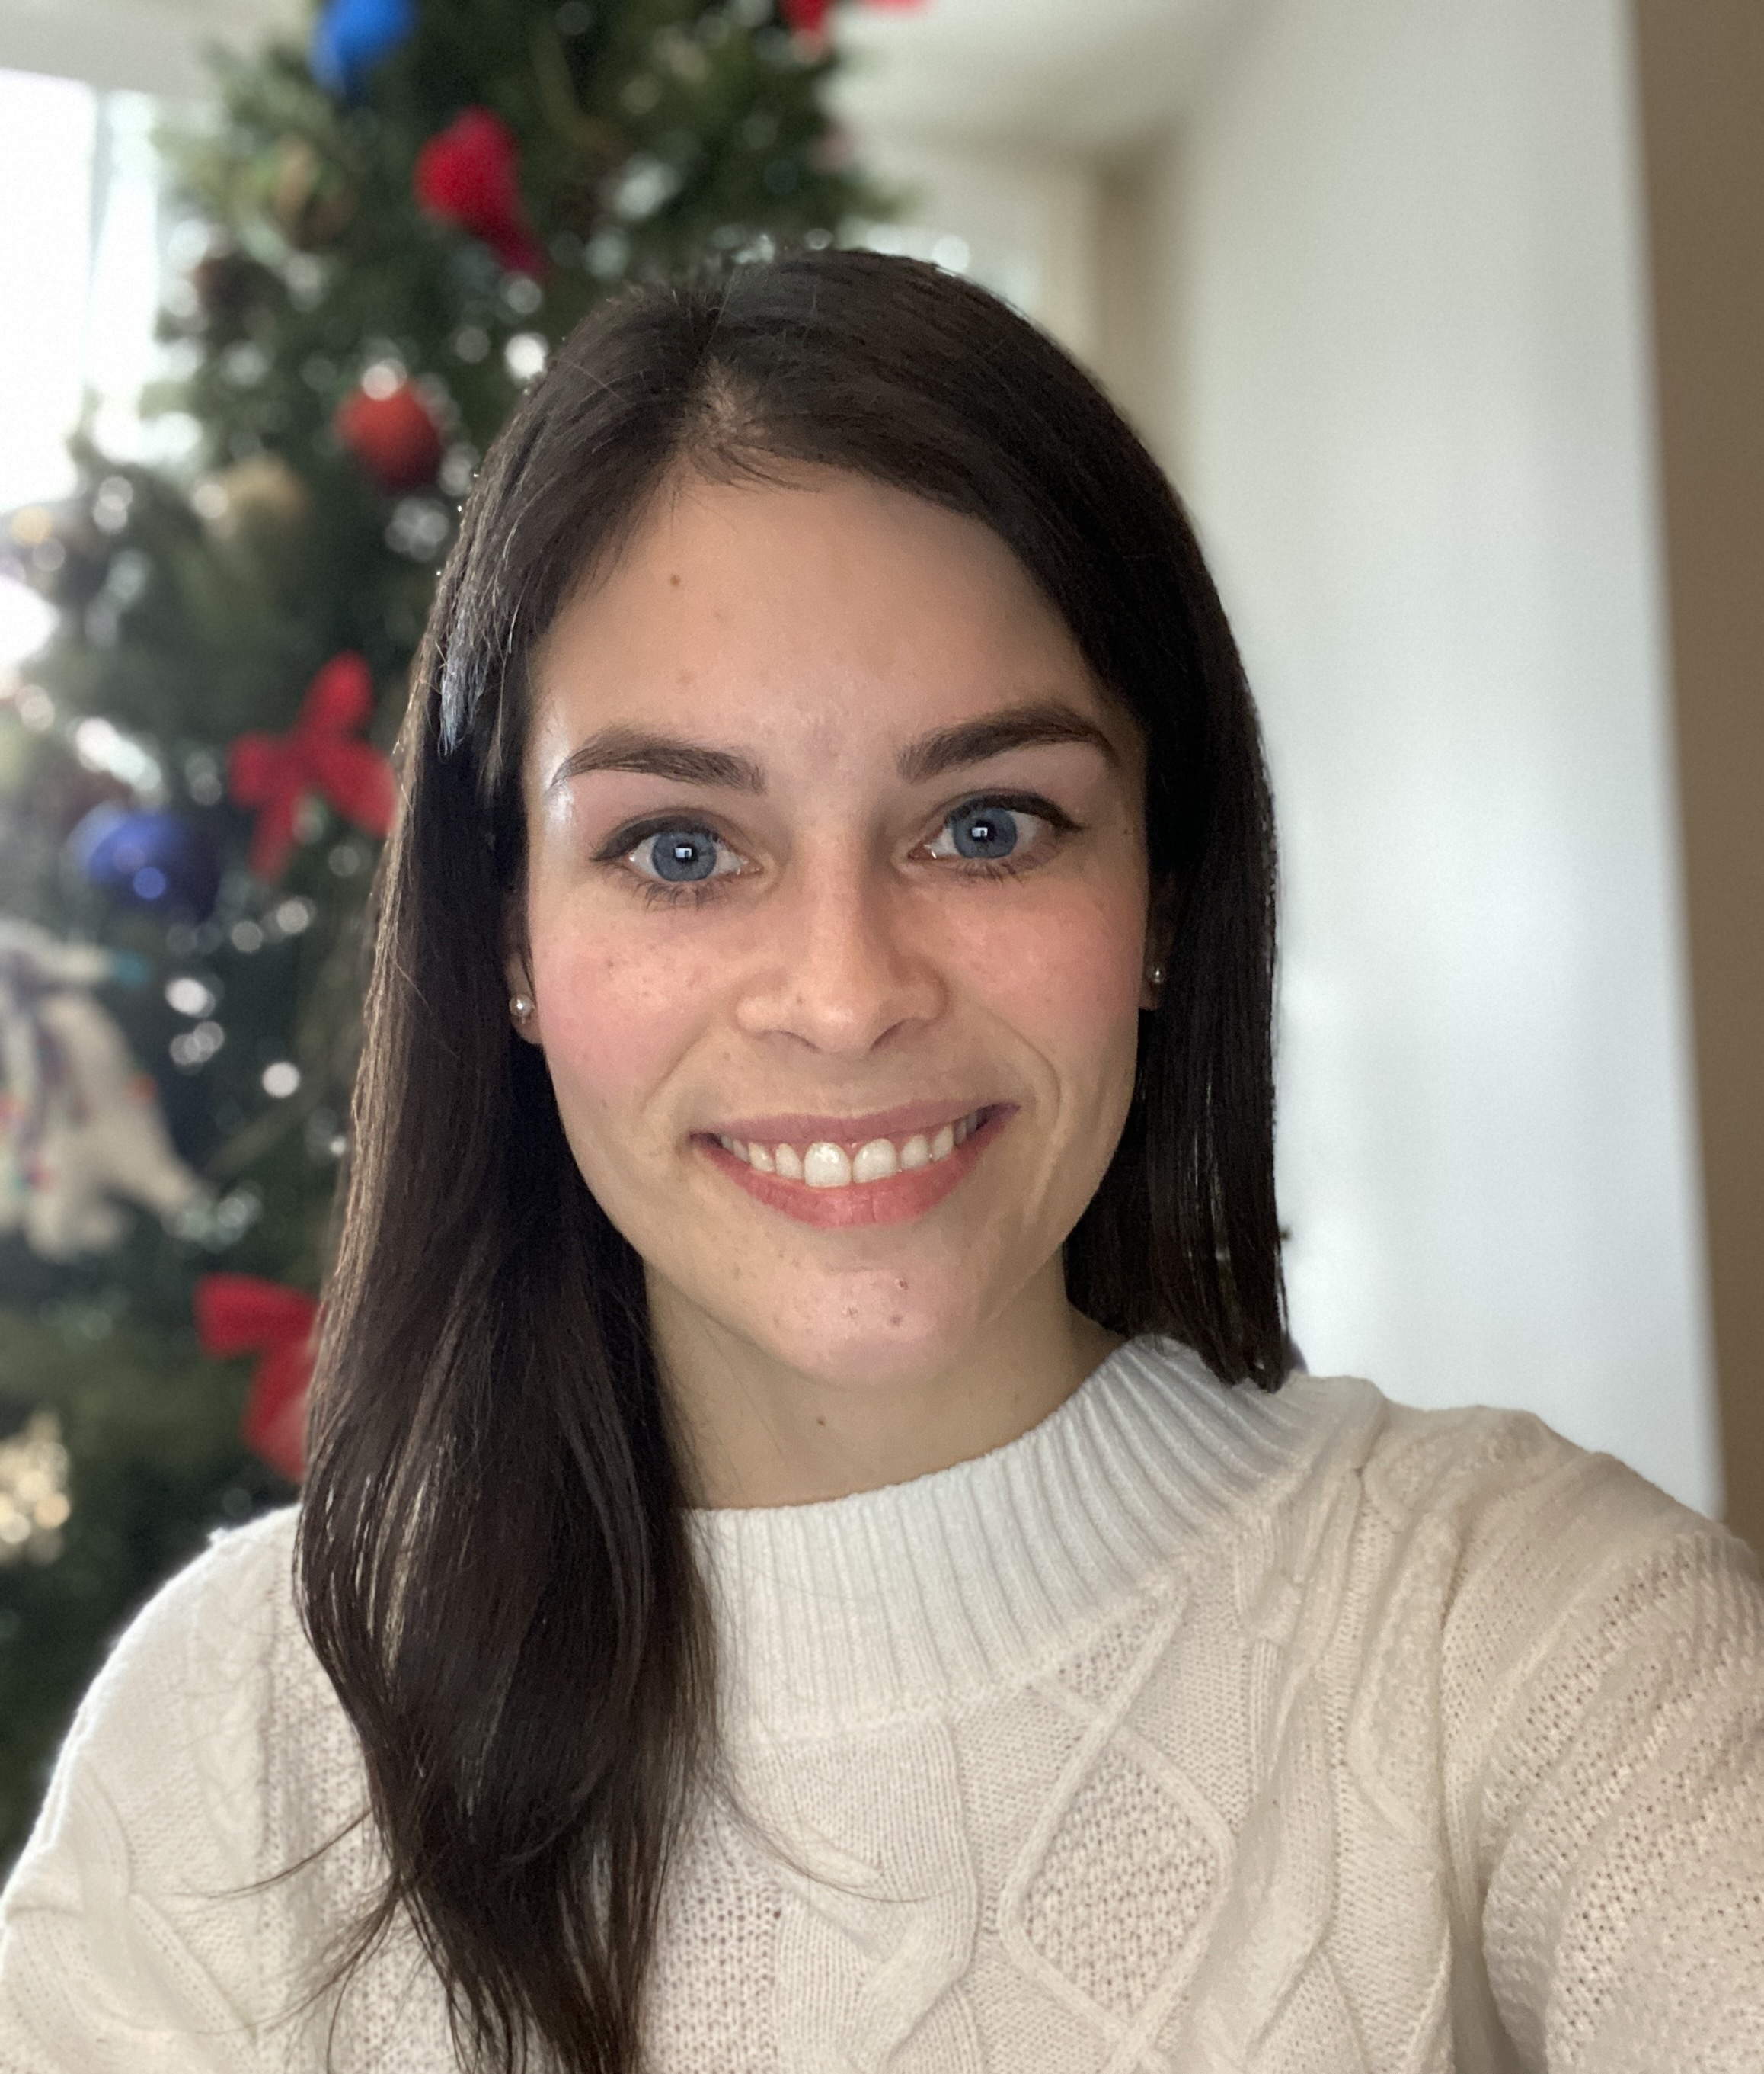
Thanks!
Dr. Andrew McArthur
Karyn Mukiri
Maddie McCarthy

